Slide 1
Life Expectancy (2024)
Across continents and within

Slide 2
Life Expectancy – the average period a person may expect to live
Lifestyle Factors: diet, activity and substance use (e.g., tobacco or alcohol) and/or abuse.
Socioeconomic Factors: social support, income, education and access to healthcare
Environmental Factors: air and water quality and living conditions
Medical Technology and Advancements

Slide 3
Objective Variables Measurable Nationally
Certain factors such as lifestyle requires a good bit of data to accurately account for
It will be more efficient to use an aggregate metric for a nation and extrapolate to factors that depend on it
For this EDA, GDP will be used to infer the status of certain factors such as
Social Support
Income
Public Health Measures
Medical Technology
General Living Conditions

Slide 4
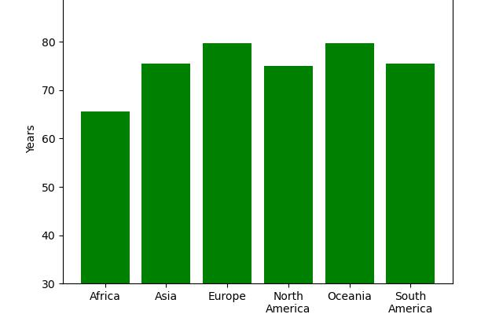
Life Expectancy for Both Sexes

